Slide 1

Lesson 5 - ROS LaserScan data and a Python Script for moving TurtleBot3
IMAT5233 Intelligent Mobile Robotics
Dr. Aboozar Taherkhani (PhD)
email: aboozar.taherkhani@dmu.ac.uk

Slide 2
Overview
LaserScan data
Create a package to subscribe to the topic related to laser scan
Write a python code to read LaserScan data
Python Script for moving TurtleBot3

Slide 3
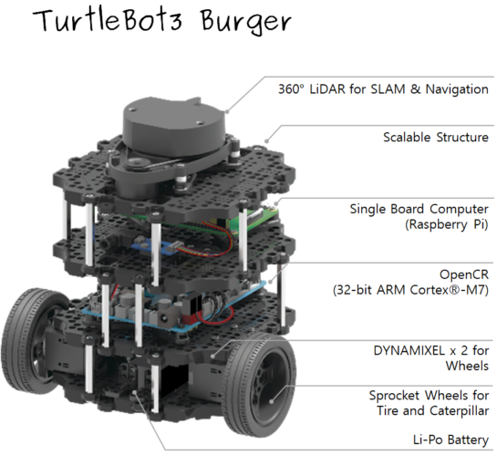
Turtolbot3 Laser Sensor
LiDAR (Light Detection and Ranging) which stands for Light Detection and Ranging, is a remote sensing method that uses light in the form of a pulsed laser to measure ranges (variable distances)
Turtolbot3 has 360° (LIDAR)
2D laser scanner that collects a set of data around the robot to use for Mapping and localization
Distance Range: 120 ~ 3,500mm
Angular Range: 360°
Angular Resolution: 1°
Notes:
https://oceanservice.noaa.gov/facts/lidar.html#:~:text=Lidar%2C%20which%20stands%20for%20Light,variable%20distances)%20to%20the%20Earth.
https://emanual.robotis.com/docs/en/platform/turtlebot3/features/#specifications

Slide 4
LaserScan data
Launch the Turtlebot3 in a non-empty environment
$ export TURTLEBOT3_MODEL=burger
$ roslaunch turtlebot3_gazebo turtlebot3_world.launch
Find about laser/scan topic
$ rostopic list
$rostopic echo [ topic name] -n1 (You could ad ‘-n1’ to only see one message from the topic)
$rostopic info [topic name] (Find the type of the message in this topic)
$rossmg show [message type] ( To see the structure of the message)

Slide 5
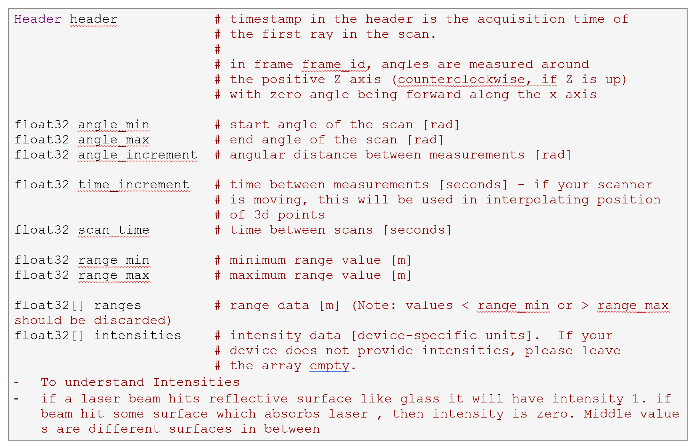
Explanation on sensor_msgs/LaserScan.msg [4]
Notes:
angle_min and angle_max show the limits of field of view in radian which is started from - angle_min to angle_max degree. The array of ‘ranges’ shows the distance from obstacle which is calculated in different direction in the field of the view. The ranges might continue 360 readings that indicate the distances of the closest obstacle in 360 direction in the 360 degree of the field of the view of the robot. See sppendix A for more information. Let have a close look at the range array.
[4] need explanation on sensor_msgs/LaserScan.msg
https://answers.ros.org/question/198843/need-explanation-on-sensor_msgslaserscanmsg/

Slide 6
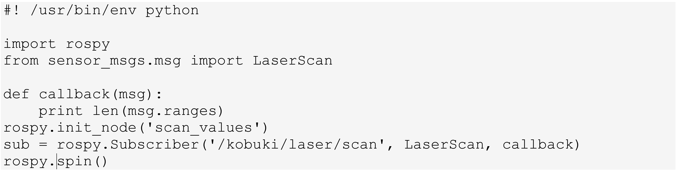
Create a package to subscribe to the topic related to laser scan
In ’catkin_ws/src’ folder create an empty package:
$catkin_create_pkg laser_values
In the src folder in the package, create a python script called ‘scan.py’
Notes:
Use the following command to convert the mode of the python file, i.e. scan.py, to an executable file: $ chmod +x src/scan.py

Slide 7
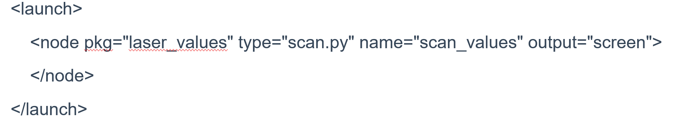
Create a package to subscribe to the topic related to laser scan
In ‘laser_values’ folder (package), create a launch folder
$mkdir launch
Create a launch file called ‘laser.launch’ for your package in the launch folder
Launch your package
$roslaunch laser_values laser.launch
Notes:
Use the following command to convert the mode of the python file, i.e. scan.py, to an executable file: $ chmod +x src/scan.py
Create a launch file called ‘laser.launch’ for your package in the launch folder that contains the subscriber node described in the ‘scan.py’ file

Slide 8
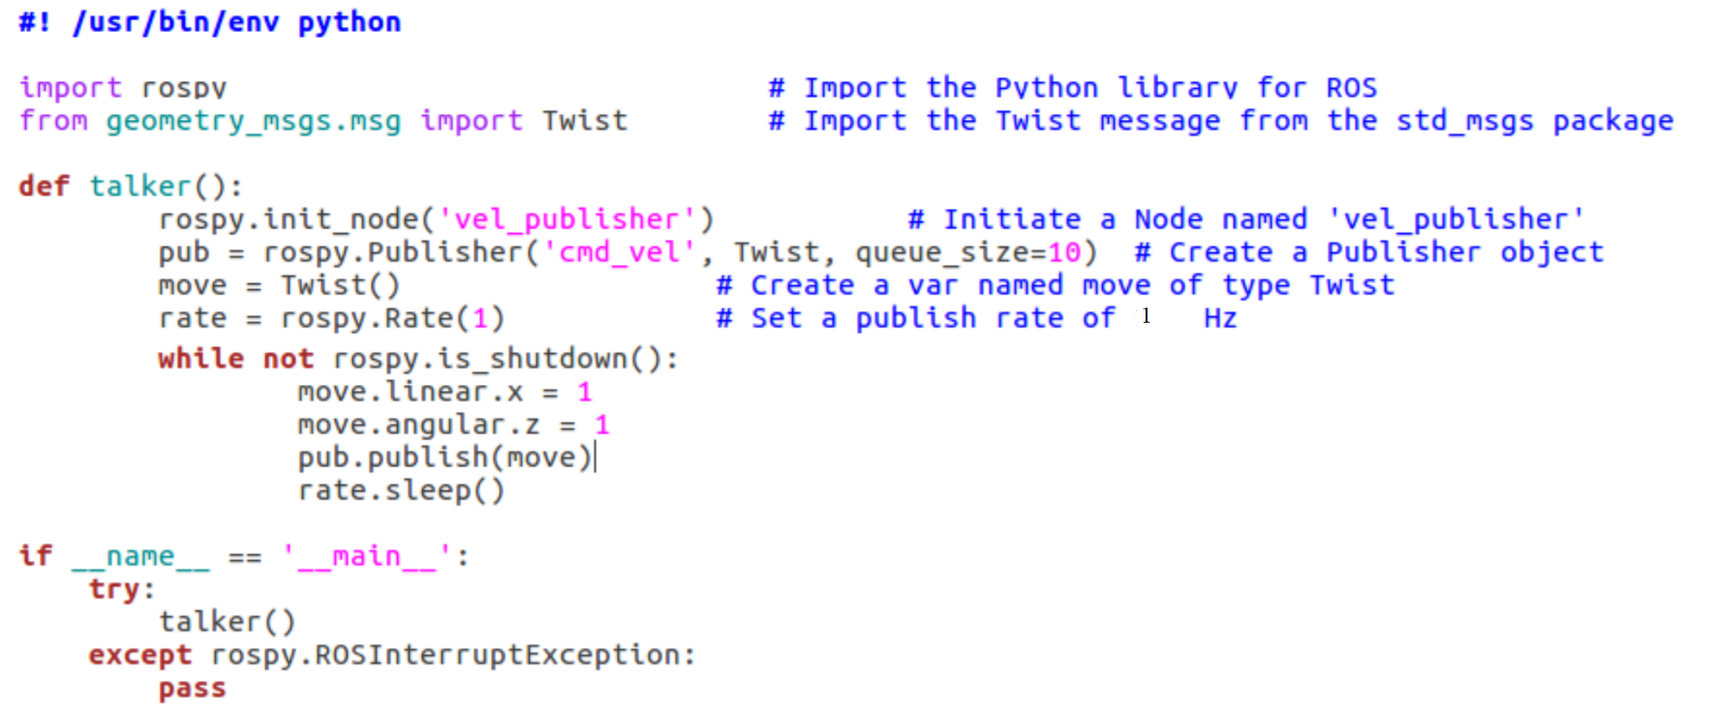
Section 2 Python Script for moving TurtleBot3

Slide 9
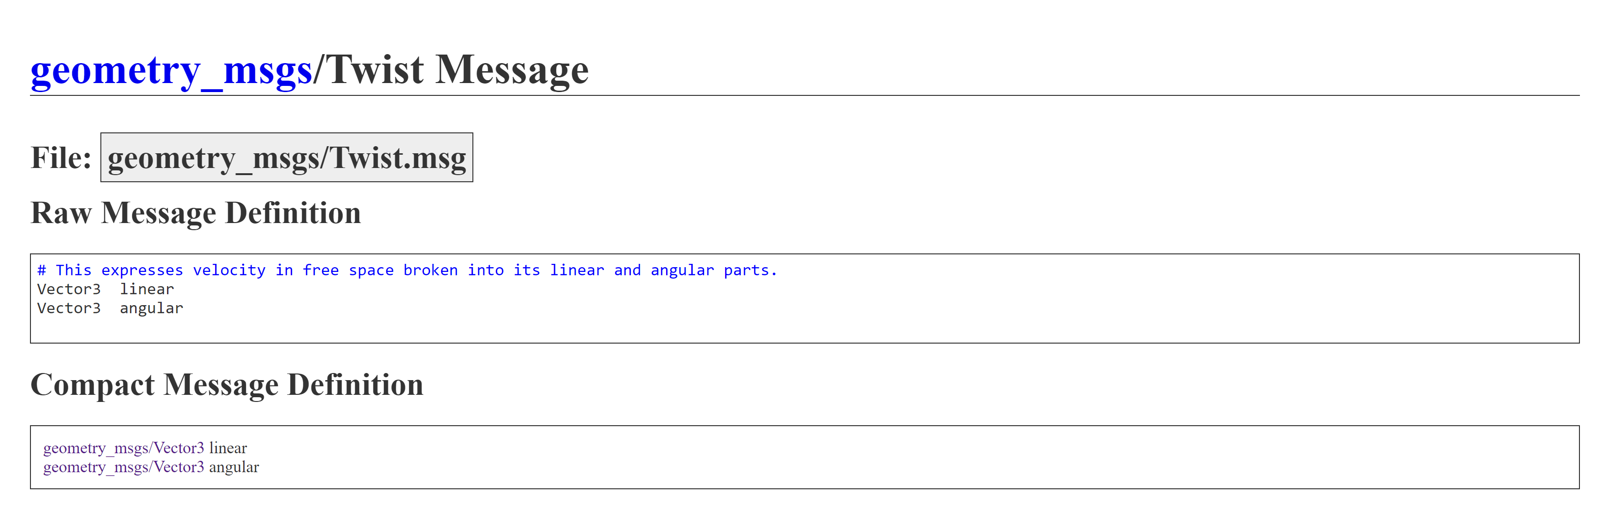
Twist() message
http://docs.ros.org/en/jade/api/geometry_msgs/html/msg/Twist.html

Slide 10
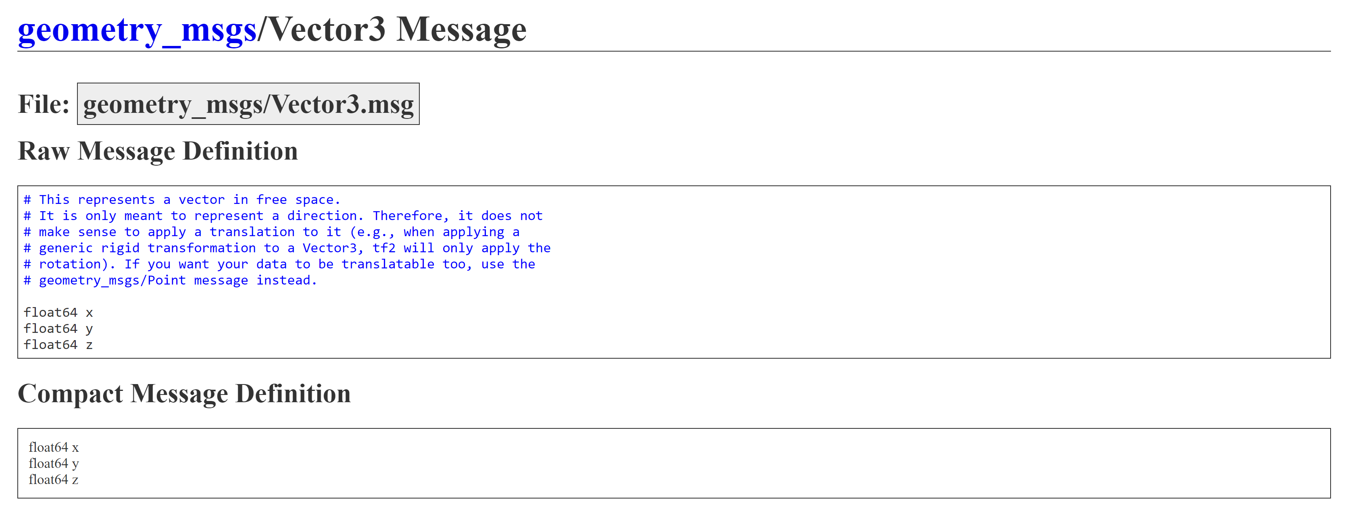
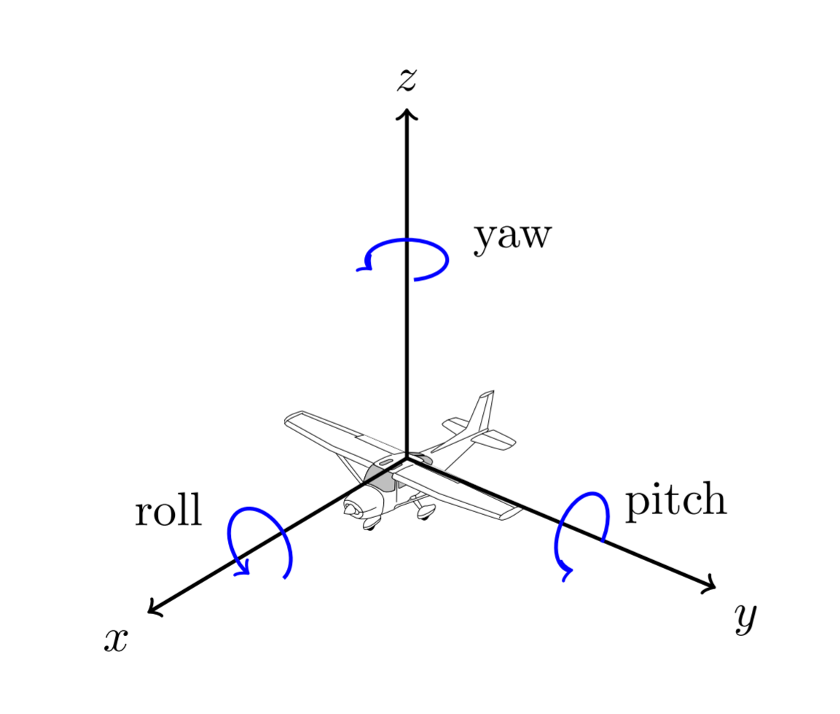
Vector3 message
Notes:
http://docs.ros.org/en/jade/api/geometry_msgs/html/msg/Vector3.html
https://w3.cs.jmu.edu/spragunr/CS354/handouts/frames.pdf

Slide 11
Python Script for moving TurtleBot3
You can run the python code using ‘rosrun’
$rosrun <package> <executable>
Or run the code using ‘roslaunch’
Create a launch file
$roslaunch <package> <.launch file>

Slide 12
Summary
LaserScan data
Create a package to subscribe to the topic related to laser scan
sensor_msgs/LaserScan.msg
Write a python code to read LaserScan data
Python Script for moving TurtleBot3

